Slide 1
West-Wide Governance Pathways Initiative
New Mexico Public Regulatory Commission
August 29, 2024

Slide 2
Pam Sporborg, Portland General Electric
Kathleen Staks, Western Freedom

Slide 3
Pathways Initiative Background

Slide 4
Launch Committee Mission
The Mission of the Launch Committee of the WWGPI (Committee) is to develop and form a new and independent entity with an independent governance structure that is capable of overseeing an expansive suite of West-wide wholesale electricity markets and related functions based on the following core principles:
The entity should enable the largest footprint possible that includes California, and maximizes overall consumer benefits;
The entity will include independent governance for all market operations;
The new entity will preserve and build upon existing CAISO market structures that serve over 80% of the Western Interconnection, including the Western Energy Imbalance Market (WEIM) and the Extended Day Ahead Market (EDAM);
A primary goal will be to minimize duplication and incurrence of costs for both the market operator and market participants; and
The structure should be flexible to accommodate the future voluntary provisions of full regional transmission organization (RTO) services for those entities that desire to do so, but not mandate that any entity must join such a future potential RTO.

Slide 5
Evaluation Criteria
1. Maximized net benefits, including reliability, affordability and environmental benefits, recognizing startup and ongoing costs, and considering both new benefits and impacts on existing benefits.
2. Equitable representation across the Western region and among all market participants, including for a wide range of legal entities.
3. A governance structure independent of any single state, participant, or class of participants.
4. Organizational flexibility to accommodate future expansion of regional solutions and to create a credible and timely path to a voluntary RTO, including the balancing authority and transmission planning functions.
5. Optionality to allow market participants to choose the market services they value.
6. Preservation of existing balancing authorities’ ability to maintain independence, authority, and governance.
7. An implementation timeline that promotes broad market participation.
8. Respect for state authority to set procurement, environmental, reliability and other public interest policies.

Slide 6
Pathways Initiative
Stepwise Process
Step 3
Step 2
Continue expanding the scope of regionalized functions and services offered by the Regional Organization
Step 1
Transfer governance authority over existing energy markets from CAISO to a new Regional Organization
Elevate WEIM/EDAM Governing Body authority in the governance of existing CAISO energy markets

Slide 7
Step 1
Final Proposal

Slide 8
Step 1: Key Elements
Step 1 elevates the WEM Governing Body’s Joint Authority with the ISO Board to Primary Authority
Initial Decisions
WEM Governing Body makes the initial decision on proposals resulting from the stakeholder process if they fall within its decision-making scope (meets the existing “apply to test)
Dual Filings
Unresolved disputes over tariff changes between WEM Governing Body and the ISO Board require the ISO to use Section 205 filing rights to present both proposals, without preference, to FERC for decision
Public Interest
Additional provisions in the Charter for WEIM and EDAM Governance focused on consumer interests and preservation of state and local authority

Slide 9
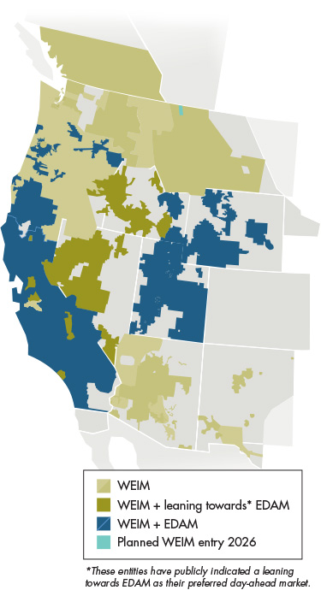
Trigger for Implementation
  Step 1 would only take effect when the following criteria are met:
Execution of EDAM implementation agreements by utilities representing load equal to or greater than 70% of ISO’s load, and
At least one new participant from both the NW and from the SW, beyond PacifiCorp, BANC, and LADWP
Purpose of the trigger:
To ensure that Step 1 expands the geographic footprint of EDAM to accelerate the benefits of greater regional coordination.

Slide 10
CAISO Step 1 Process
On June 5, 2024, the Launch Committee of the Pathways Initiative submitted for consideration its Step 1 Recommendation to the ISO Board Chair Jan Schori and then-WEIM Governing Body Chair Andrew Campbell.
CAISO conducted a thorough stakeholder process
  Two stakeholder calls (June 18, July 23)
  Written comment period
ISO Board and WEM Governing Body unanimously approved the Step 1 proposal at a joint meeting on August 13
Governance documents and tariff changes will be drafted and brought for decision at later date, closer to trigger being met

Slide 11
Phase II/Step 2
Work Plan and Timeline

Slide 12
Launch Committee Mission
The Mission of the Launch Committee of the WWGPI (Committee) is to develop and form a new and independent entity with an independent governance structure that is capable of overseeing an expansive suite of West-wide wholesale electricity markets and related functions based on the following core principles:
The entity should enable the largest footprint possible that includes California, and maximizes overall consumer benefits;
The entity will include independent governance for all market operations;
The new entity will preserve and build upon existing CAISO market structures that serve over 80% of the Western Interconnection, including the Western Energy Imbalance Market (WEIM) and the Extended Day Ahead Market (EDAM);
A primary goal will be to minimize duplication and incurrence of costs for both the market operator and market participants; and
The structure should be flexible to accommodate the future voluntary provisions of full regional transmission organization (RTO) services for those entities that desire to do so, but not mandate that any entity must join such a future potential RTO.

Slide 13
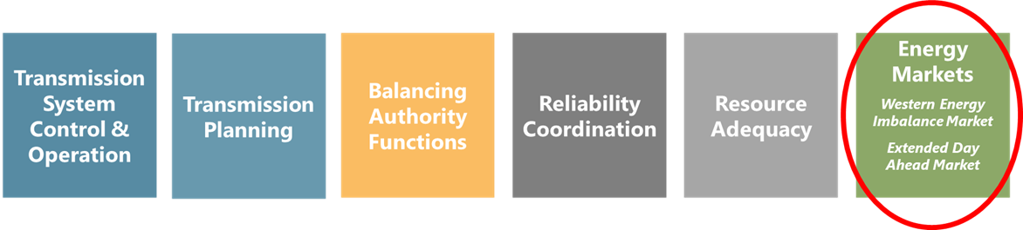
Pathways Expands Regional Coordination in Energy Markets But Leaves Other CAISO Functions Untouched

Slide 14
Phase II Work Plan
Phase II of the Pathways Initiative will consist of refining the Step 2 proposal, and run from June-December 2024.
Step 2 has numerous open questions and remains under development as described in the straw proposal.
Step 2 Work Streams have been created, with two leads assigned to each, to address open issues.
Some topics will be addressed in public virtual workshops (topics and dates still under development) during the summer, open to all stakeholders.
The Stakeholder Process Work Stream will be addressed through an independently facilitated process to structure more opportunities for stakeholder participation.

Slide 15
Workshop Schedule and Topics
July 10: Stakeholder Process Workshop #1
  Introduction to Gridworks Briefing document with comparative analysis of stakeholder processes across the country
  Discussion of issues and goals for Stakeholder Process work stream
July 24: Stakeholder Process Workshop #2
  How could issues and solutions before the Regional Organization get raised? Who leads?
July 25: RO Formation and Governance
  State of incorporation, Principal place of business, RO entity formation status
  For shared authority, RO Board and CAISO BoG joint sessions; nominating and selection process for RO Board; number of RO Board seats; seats reserved for particular sectors; transition from the WEIM GB to RO Board process; any pre-launch of the RO prior to legislation
    Comment period: July 25-Aug 8
August 2: Stakeholder Process Workshop #3
  What could a sector-based committee and voting structure add?
    Comment period: Aug 2-Aug 16

Slide 16
Workshop Schedule and Topics
August 5: Tariff Analysis and CAISO Issues
  Authority/rights retained by CAISO; RO compliance, financial obligations, liability; RO/CAISO staffing structure
  Tariff provisions that would fall under the RO Sole Authority; Decisional process for making the determination when addressing new market design, other initiatives, or “new services”; shared authorities under certain instances and what those provisions may be
    Comment period: Aug 5-Aug 19
August 15: Public Interest
  Role of States Committee and Consumer Advocates
    Comment period: July 31-August 14
August 28: Stakeholder Process Workshop #4
  Reviewing a Draft Stakeholder Engagement Straw Proposal

Slide 17
Step 2 Work Streams and Leads
Stakeholder Process:
    Leads: Pam Sporborg and Kathleen Staks
      Example issues: policy topic framing, sector-based approaches
CAISO Issues:
    Leads: Spencer Gray and Evelyn Kahl
      Example issues: RO financial liability, contract privity
Existing Tariff Analysis:
    Leads: Tony Braun and Scott Ranzal
      Example issue: balancing authority function identification
Public Interest Issues:
    Leads: Carl Linvill and Kathleen Staks
      Example issue: BOSR evolution, consumer advocate participation
RO Formation:
    Leads: Lisa Hickey and Evelyn Kahl
      Example issue: form of incorporation
RO Governance:
    Leads: Jim Shetler and Jan Smutny-Jones
      Example issues: RO board nomination, RO funding source

Slide 18
Anticipated timeline for Step 2
July-Aug: Stakeholder Workshops
Sep 2-26: Drafting of Step 2 Draft Revised Proposal
Sept 26: Issue Step 2 Draft Revised Proposal
Sept 26-Oct 25: Open comment period (4 weeks)
Oct 4: Monthly Stakeholder Meeting (review Step 2 Draft Revised Proposal)
Oct 25: Comments due on Step 2 Draft Revised Proposal
Oct 28-Nov 14: Incorporate stakeholder feedback and make revisions to Step 2 Final Proposal
Nov 15: Issue Step 2 Final Proposal
Nov 22: Monthly Stakeholder Meeting (review Step 2 Final Proposal and vote)

Slide 19
Thank You.

