Slide 1
Western Resource Adequacy Program
August 29, 2024
Michael O’Brien
Senior Engagement Manager, WPP WRAP
New Mexico PRC – Regional Market Workshop

Slide 2
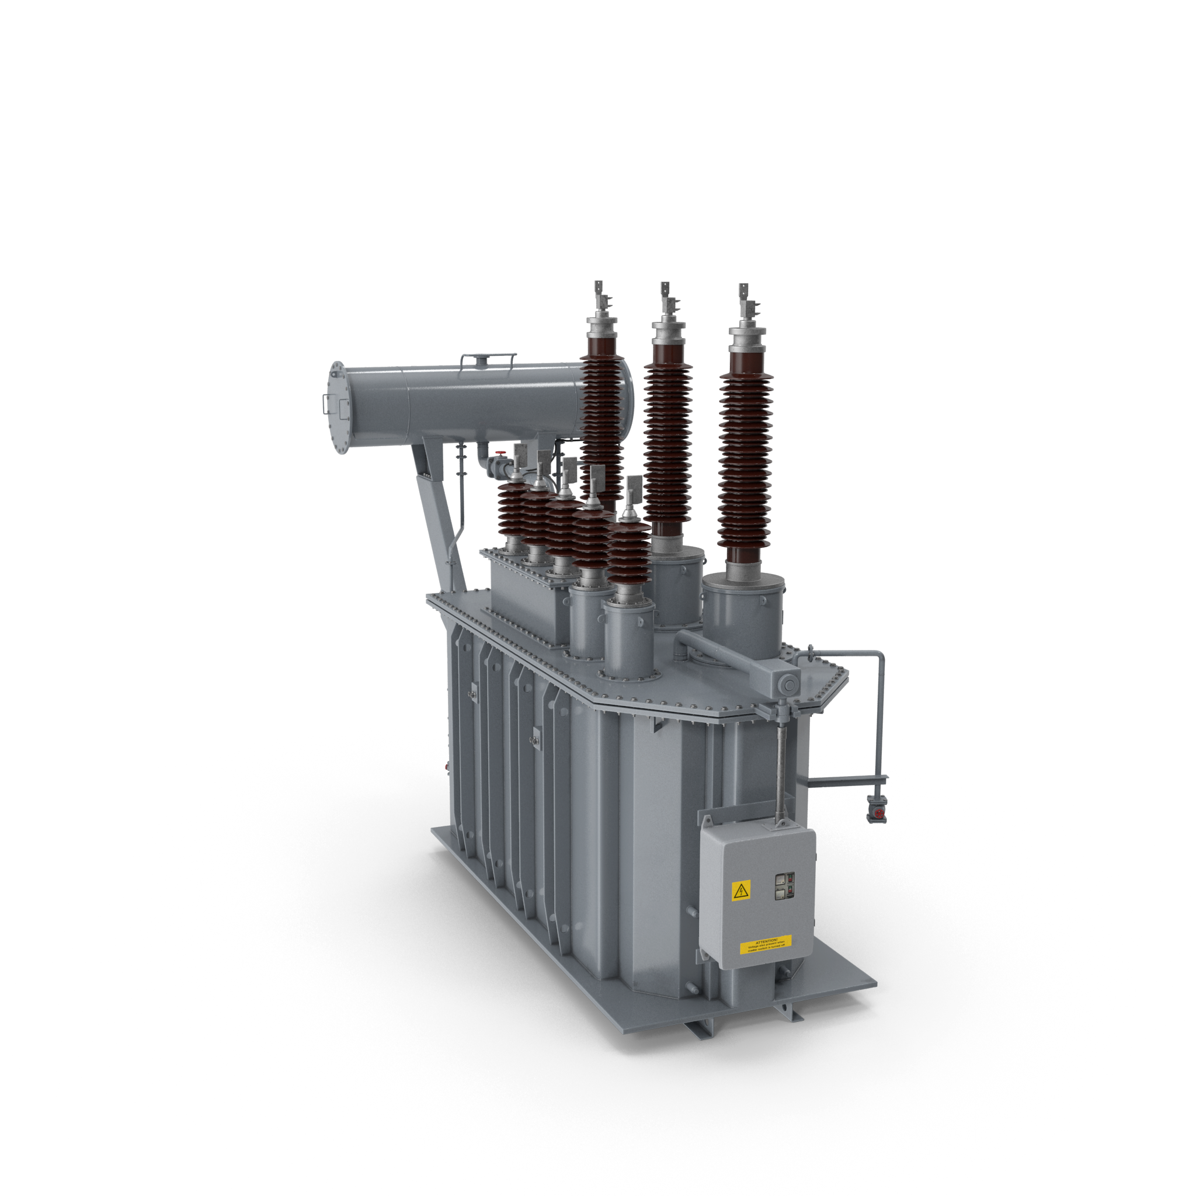
WRAP Overview
Western Power Pool
Program Roles
Value Proposition
Forward Showing
Operation Program
Interoperability with EDAM and Markets +
Current Status
Future Implementation & Revised Transition Plan
WestTEC

Slide 3
WPP Provides a Range of Valuable Grid Integration and Coordination Services to its Customer-Members throughout the entire Western Interconnection
Transmission Services
Training
Resource Adequacy*
Frequency Response Sharing Group
Hydro Modeling
Reserve Sharing Group
*Under WPP independent governance (others governed by participants or agreements)

Slide 4
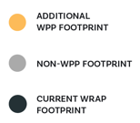
Current WRAP Participants Arizona Public Service Avista Bonneville Power Administration Calpine Chelan County PUD Clatskanie PUD Eugene Water & Electric Board Grant PUD Idaho Power Northwestern Energy NV Energy PacifiCorp Portland General Electric Powerex Public Service Company of New Mexico Puget Sound Energy Salt River Project Seattle City Light Shell Energy Snohomish PUD Tacoma Power The Energy Authority

Slide 5
Roles of the PA and PO
Western Power Pool (WPP) serves as the Program Administrator (PA) of the WRAP
Undertakes all actions necessary to implement and administer program
Southwest Power Pool (SPP) serves as the Program Operator (PO) of the WRAP
Provides technical, analytical, and implementation support to the Program Administrator

Slide 6
WRAP VALUE PROPOSITION
Binding forward showing requires Participants to show they have secured their share of the regional capacity need for the upcoming season using common planning and capacity accreditation metrics
Binding operational program obligates Participants with surplus to assist Participants with a deficit in the hours of highest need using bilateral trading mechanisms
Set of common analytically derived reliability metrics
Leveraging load and resource diversity for reliability

Slide 7
Program Design Overview Forward Showing
Determine Program Capacity Requirement
Determine Resource Capacity Contribution
Compliance Review of Portfolio
Establishes a regional reliability metric (seasonal 1 event-day in 10 years LOLE)
Transition away from utility-by-utility RA programs and assumptions
Registered resources receive a Qualifying Capacity Contribution (QCC) in advance of forward showing deadlines (seven months ahead of winter and summer seasons)
Resource-agnostic, consistent methodology for assessing capacity contribution
Non-compliance with forward showing requirements (capacity or transmission) results in a Forward Showing Deficiency Charge

Slide 8
Program Design Overview Operations Program
FS Expectations
Operational Reality
Sharing Requirement
Evaluates participants operational situation relative to Forward Showing assumptions
Obligates participants with calculated surplus to assist participants with a calculated deficit on the hours of highest need
Surplus Participant that fails to provide assigned Energy Deployment must pay Energy Delivery Failure Charge

Slide 9
WRAP Interoperability
WPP fully supports market expansion and has been an active stakeholder in the development of both EDAM and Markets+
The designs of both markets are capable of accommodating WRAP - WPP continues to work successfully with CAISO & SPP
Maintain WRAP value proposition: Participants access to the capacity demonstrated in the Forward Showing and ability to deliver in the Operations Program
Both markets are incremental (not a full RTO) so BA OATTs will need to be adapted to accommodate the new market tariffs

Slide 10
2023-2024 Implementation
BPM Drafting Process
Opportunities for public comment
August 23 2023
Board adoption of BPMs 105, 201, 206
December 6 2023
Board adoption of BPMs 101, 109, 210, 301, 302, 303
March 7 2024
Board adoption of BPMs 104, 107, 108, 304
June 13 2024
Board adoption of 5 BPMs
September 19 2024
Board adoption of 6 BPMs & Tariff NTFs
Begin Official Tariff/BPM Revision Process
February 2023
Seated Independent Board
2023 Q1
2023 Q2
2023 Q3
2023 Q4
2024 Q1
2024 Q2
2024 Q3
2024 Q4
Winter 2023-2024
(NB Ops)
Summer 2024
(NB Ops)
Winter 2024-2025
(NB Ops)
March 31 2024
Non-Binding FS – Winter 2024-2025
June 1 2024
Non-Binding Ops – Summer 2024
October 31 2024
Non-Binding FS – Summer 2025
November 1 2024
Non-Binding Ops – Winter 2024-25
Winter Season: November – March 15
Summer Season: June – September 15

Slide 11
Future Implementation
On April 22, the RAPC published a letter to the region reaffirming commitment to the program and highlighting significant developments since WRAP development began:
Participants have been pursuing new resources and increasing efforts on transmission development
Supply chain issues and other challenges have slowed the ability to deliver and interconnect new resources, with peak loads growing faster than ever, exacerbated by extreme weather events
Given the potential magnitude of deficiency charges, concern about binding in Summer 2026 – instead, taking advantage of the flexibility allowed by the Tariff (§15), Participants are going to focus on pulling together a critical mass for 2027
Participants are developing a proposal for a revised transition plan to address concerns
Transition Seasons (Ops and FS)
Summer 25 through Winter 27-28
Summer
(NB)
Summer
(transition)
Summer
(transition)
Summer
(binding)
2025
2026
2027
2028
Winter
(transition)
Winter
(transition)
Winter
(transition)
Targeting Binding Program With Revised Transition Provisions
Modified Excused Transition Deficits and Cone Charge Deductions
Binding Program Without Transition Provisions
Summer 28 and all seasons following

Slide 12
Revised Transition Plan
Concept | Change/Addition
Transition Period | Extended from June 1, 2025 through March 15, 2029
Binding Season | Deadline to select Summer 2027 as first binding season moved to January 15, 2026 Summer 2027 LOLE modelling will include all Participants regardless of binding season Exit window date for Winter 27/28 remains the same (October 31, 2025)
Critical Mass | If less than “Critical Mass” in subregion, Participants in that subregion may elect to be non-binding Thresholds to be defined in a future BPM or BPM update Persists beyond transition period
ETDs | “Discounted Deficiency Charge” + ETDs in Summer 27, Winter 27/28 limited to 200% FSPRM MWs Drops to 100% FSPRM in Summer 28 and Winter 28/29
Diversity Sharing | PRM calculation includes 500 MW of diversity sharing between subregions Benefitting NW in Winter, SW in Summer Limited to WRAP Regional LOLE Study Result PRM Applies for transition period, reevaluation no later than 2030
Operations Program Data | Participants to provide disaggregated data to Operations program Aiming for plan and timeline by end of 2024

Slide 14
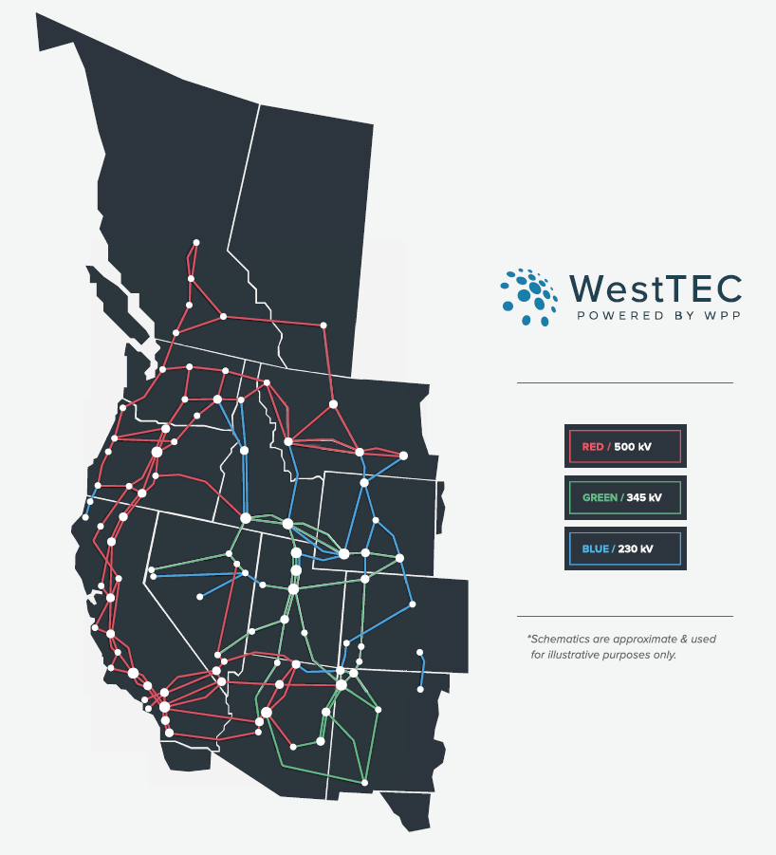
What is the Western Transmission Expansion Coalition (WestTEC)?
WestTEC is not a FERC Process (although potential synergies with Order 1920)
Industry-led with unprecedented stakeholder inclusion
Goal is to produce an actionable transmission study that is useful to planners, developers, regulators and the study’s regional partners
Create transmission portfolios addressing 10-year and 20-year needs

Slide 15
Questions?
wrap@westernpowerpool.org

