Slide 1
Xcel Energy/SPS 2023 IRP
NM PRC Special Open Meeting
February 15, 2024
Staff Presentation

Slide 2
Staff IRP Report
Staff filed its Report on January 26, 2024
Staff believes that SPS’ 2023 IRP has complied with the policies and the procedures of the IRP rule
  Staff made a number of recommendations to SPS to achieve the most cost-effective portfolio of resources

Slide 3
Modeling Scenarios
3 Demand Forecasts
  Financial (low)
  Planning (mid)
  Electrification (high)
4 Technologies
  MJB – multi-jurisdictional base case (cheapest)
  ET – existing clean energy technologies (most expensive)
  Long duration storage (3 to 5-year projected lead time)
  Hydrogen conversion (model favors short duration storage over hydrogen)
3 Contingencies
  SPP Planning Reserve Margins increase from 15% to 18% summer/20% winter
  Natural Gas and Market Energy Price Uncertainty
  Transmission Network Upgrade Cost Uncertainty

Slide 4
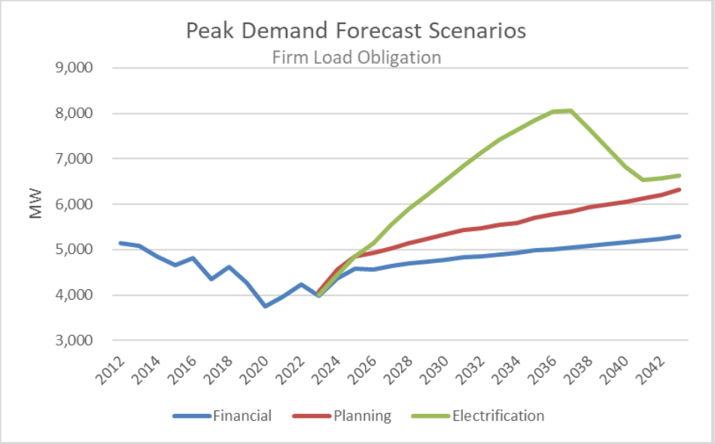
Load Forecast and Resource Additions
Range of Resource Additions through 2043
(Nameplate capacity under 4 technology cases)
16,149 – 21,400 MW
16,455 – 22,999 MW
12,595 – 18,449 MW

Slide 5
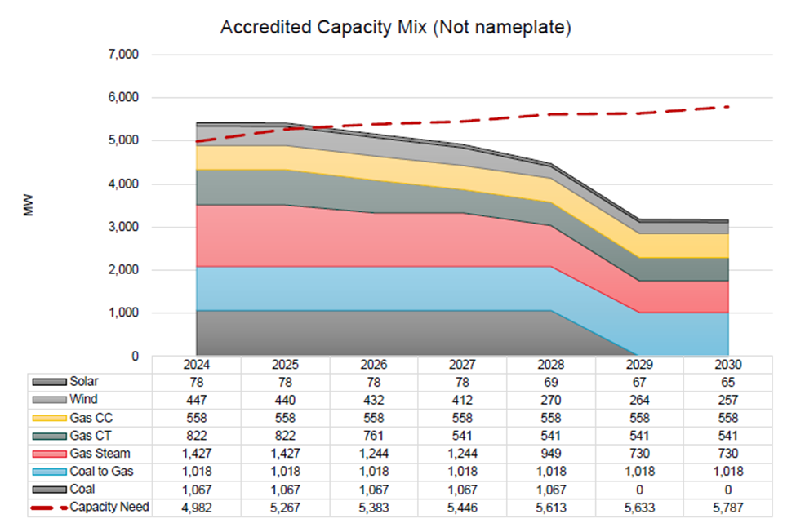

Slide 6
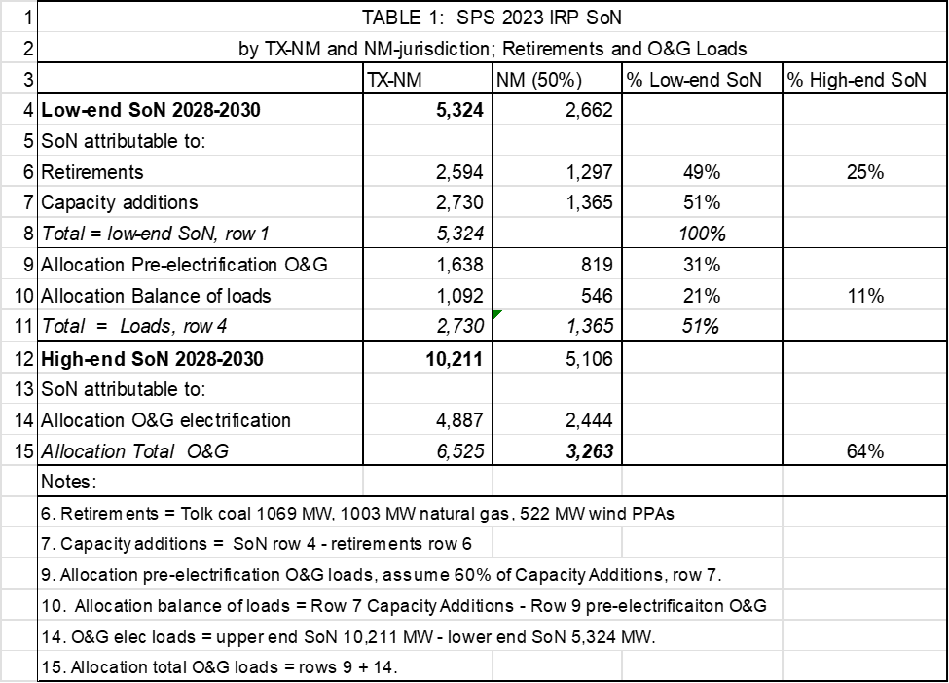
Retirements and Loads: 2028 -2030
Low-end = Planning forecast, High-end = Electrification forecast

Slide 7
Staff Recommendations
1. SPS should provide an update to its load forecast to reflect changes in projected grid-connected O&G loads. Staff understands that SPS intends to update its load forecast before it issues its RFP for resources.
2. SPS should use best efforts to extend the life of its utility-owned gas-steam units scheduled for retirement provided it allows the utility to meet its carbon reductions under the ETA. It should also use best efforts to renew expiring gas, wind, and solar PPAs. These resources should be allocated to reducing SPS’s New Mexico-specific SoN if Texas’ current allotment is not renewed.
3. SPS should provide updates on the progress of Southwest Power Pool (SPP) work and analyses on the effective capacities of wind, solar, and battery storage. This may have the effect of increasing the Effective Load Carrying Capability (ELCC) of these variable resources.
4. SPS should provide the Commission with updates on the progress of SPP work and analyses incorporating transmission expansion opportunities.
5. The Standby tariff should be revised to match the increase in the LGS tariff from the SPS rate case.
6. LGS and Standby tariffs should reflect SPS’s changing load profile and cost of service.
7. SPS should reduce O&G connected load through voluntary program(s) and/or Special Service Contracts.

