Slide 1
Cisa cybersecurity
Mission
Andrew Buschbom
Cybersecurity State Coordinator
Region VI | New Mexico

Slide 2
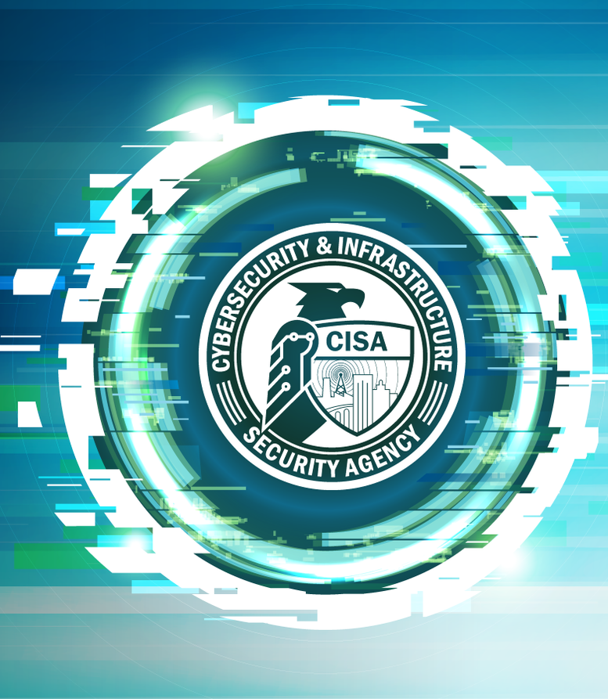
About CISA

Slide 3
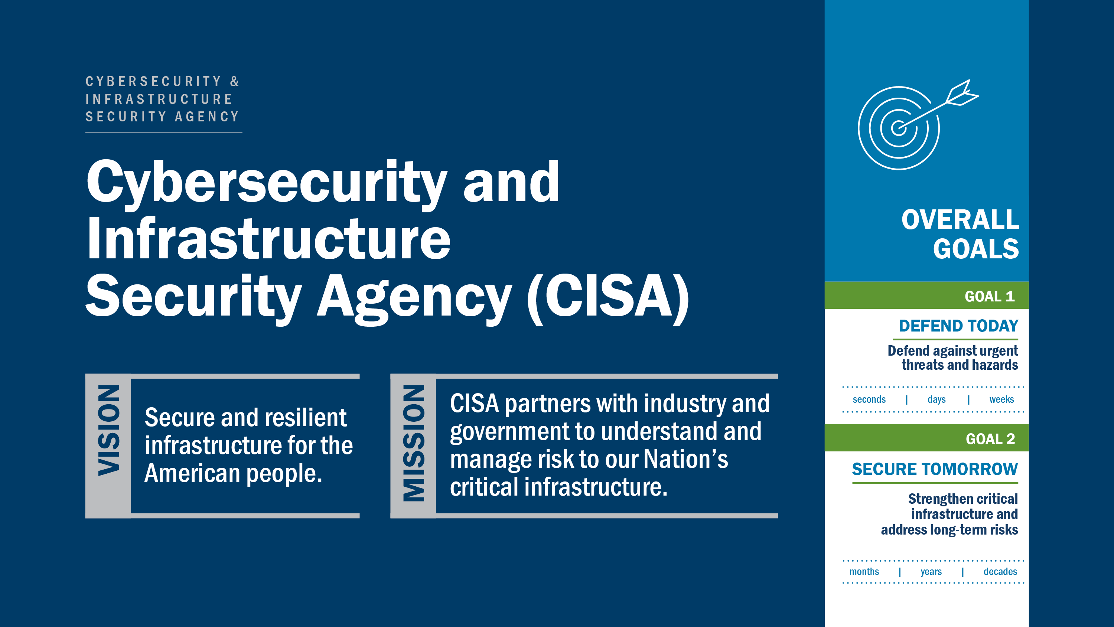
Notes:
CISA leads the federal effort to help safeguard the Nation’s critical infrastructure from both cyber and physical threats and vulnerabilities.

Slide 4
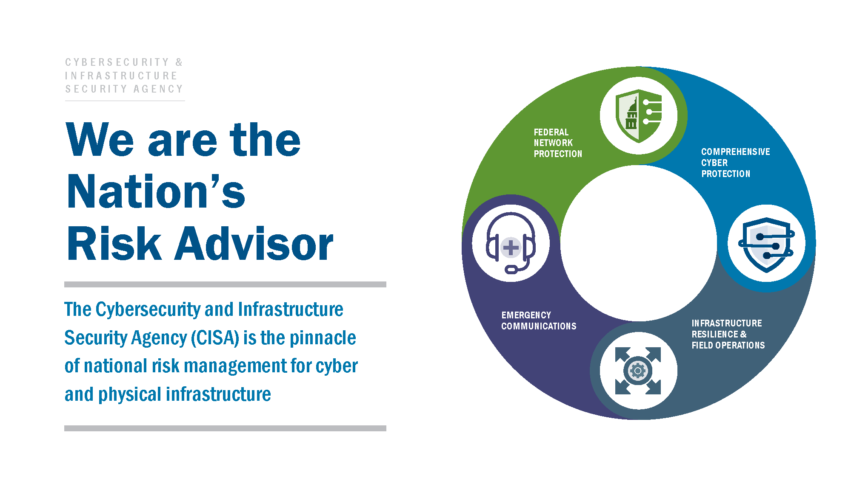

Slide 5
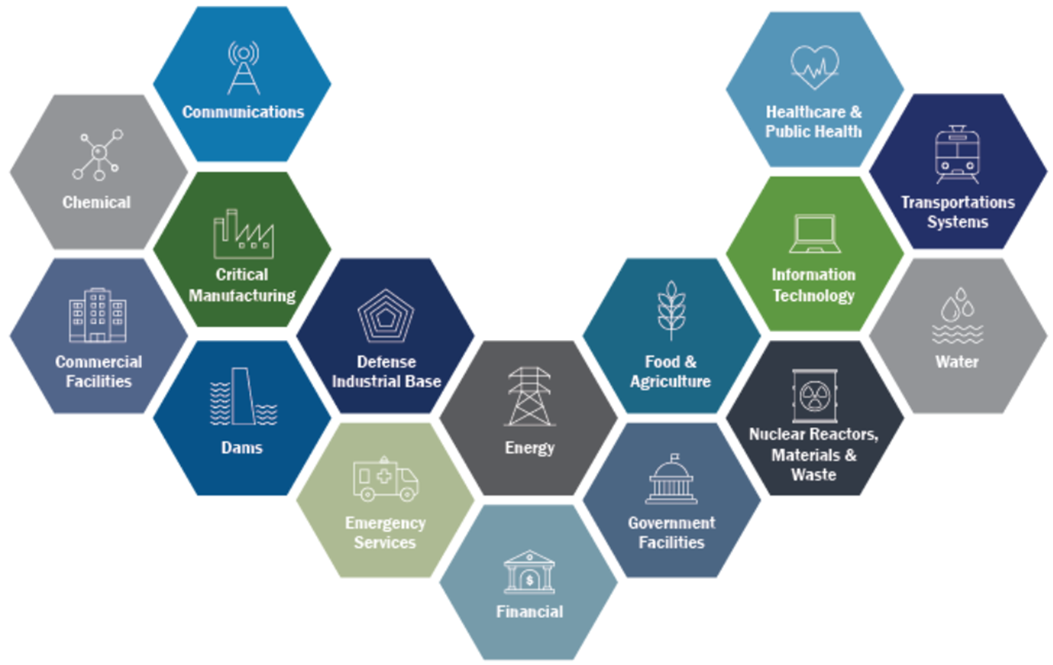
Critical Infrastructure Sectors
CISA assists the public and private sectors secure its networks and focuses on organizations in the following 16 critical infrastructure sectors.

Slide 6
Cybersecurity Advisors (CSAs)
To provide direct coordination, outreach, and regional support in order to protect cyber components essential to the sustainability, preparedness, and protection of the Nation’s Critical Infrastructure and Key Resources (CIKR) and State, Local, Tribal, and Territorial (SLTT) governments.
Assess: Evaluate critical infrastructure cyber risk.
Promote: Encourage best practices and risk mitigation strategies.
Build: Initiate, develop capacity, and support cyber communities-of-interest and working groups.
Educate: Inform and raise awareness.
Listen: Collect stakeholder requirements.
Coordinate: Bring together incident support and lessons learned.

Slide 7





Reg 6 | On-Hand / Projected Cyber Personnel
On-Hand
Projected

Slide 8
Cybersecurity Resources and Services

Slide 9
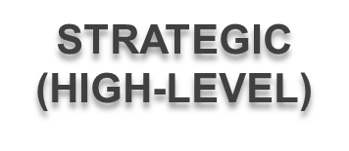

CISA Cybersecurity Resources
Regional Resources:
Cybersecurity Assessments
  Cybersecurity Performance Goals (CPG)
  Ransomware Readiness Assessment (RRA)
  Cyber Infrastructure Survey (CIS)
  Cyber Resilience Essentials (CRE)
  External Dependencies Management (EDM)
  Incident Management Review (IMR)
  Cyber Resilience Review (CRR)
Workshops
  Cyber Resilience Workshop (CRW)
  Asset Management Workshop (ARW)
  Incident Management Workshop (IMW)
  Vulnerability Management Workshop (VMW)
  Digital Forensics Workshop I & II (DFW)
  Cyber Exercise (CYX)
National Resources:
Vulnerability Scanning Service (CyHy)
Cyber Tabletop Exercises (CTTX)
TECHNICAL
(LOW-LEVEL)
Notes:
Just acknowledge we have assessments to align with a logical progression of resources (Intro, Intermediate, and Advanced) as you will brief them in the following slides.
We have workshops typically used following an assessment to bolster identified areas requiring attention or improvements.

Slide 10

Cybersecurity Performance Goals (CPGs)
The CPGs are a prioritized subset of IT and operational technology (OT) cybersecurity practices that critical infrastructure owners and operators can implement to meaningfully reduce the likelihood and impact of known risks and adversary techniques.
The goals were informed by existing cybersecurity frameworks and guidance, as well as the real-world threats and adversary tactics, techniques, and procedures (TTPs) observed by CISA and its government and industry partners.
By implementing these goals, owners and operators will not only reduce risks to critical infrastructure operations, but the also the American people.

Slide 11
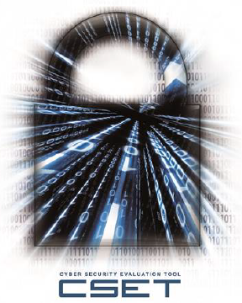
Ransomware Readiness Assessment (RRA)
To understand your cybersecurity posture and assess how well your organization is equipped to defend and recover from a ransomware incident, take the Ransomware Readiness Assessment (RRA). The RRA is a self-assessment based on a tiered set of practices to help organizations better assess how well they are equipped to defend and recover from a ransomware incident.
The RRA:
Helps organizations evaluate their cybersecurity posture, with respect to ransomware, against recognized standards and best practice recommendations in a systematic, disciplined, and repeatable manner.
Guides asset owners and operators through a systematic process to evaluate their operational technology (OT) and information technology (IT) network security practices against the ransomware threat.
Provides an analysis dashboard with graphs and tables that present the assessment results in both summary and detailed form.

Slide 12
National Resources

Slide 13
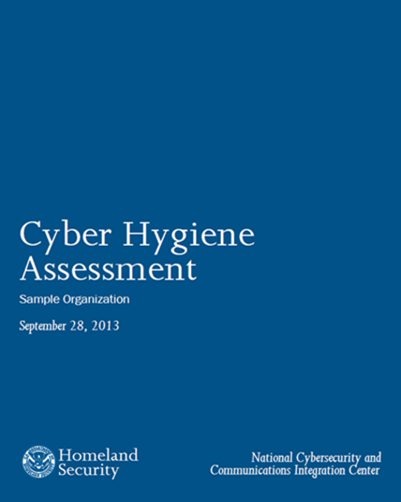
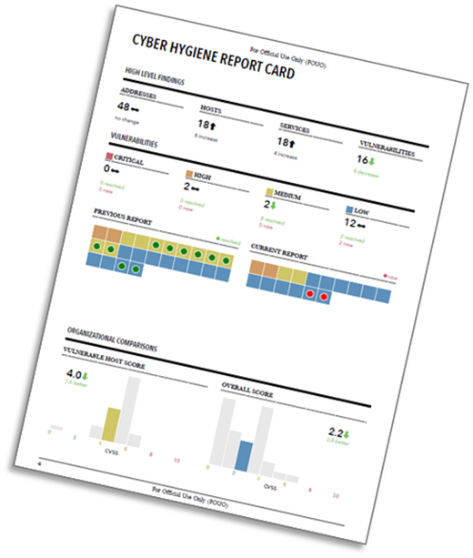
Vulnerability Scanning Service (CyHy)
Assess Internet accessible systems for known vulnerabilities and configuration errors
Work with organization to proactively mitigate threats and risks to systems
Activities include:
Network Mapping
  Identify public IP address space
  Identify hosts that are active on IP address space
  Determine the O/S and Services running
  Re-run scans to determine any changes
  Graphically represent address space on a map
Network Vulnerability & Configuration Scanning
  Identify network vulnerabilities and weakness

Slide 14
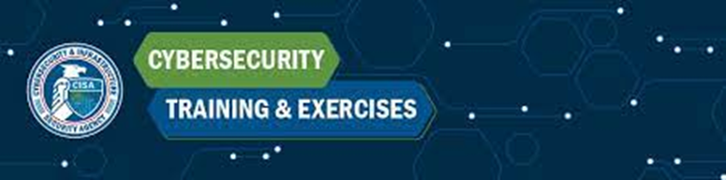
Cyber Exercise & Planning Program
CISA provides end-to-end exercise planning and conduct support, including planning meetings, document and scenario development, facilitation, and after-action report development.
CISA offers the following services at no-cost on an as-needed and as-available basis:
Cyber Storm Exercise (CISA’s flagship national level cyber exercise)
End-to-End Cyber Exercise Planning
Cyber Exercise Consulting
Cyber Planning Support
Exercise-In-A-Box
Virtual CTTX

Slide 15
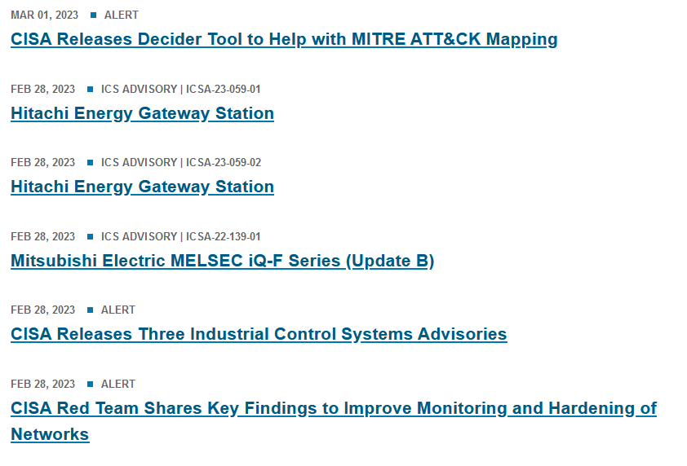
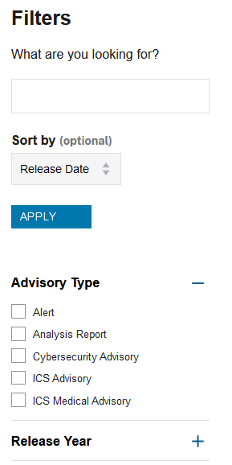
Cybersecurity Alerts & Advisories
https://www.cisa.gov/news-events

Slide 16
Cyber Training

Slide 17
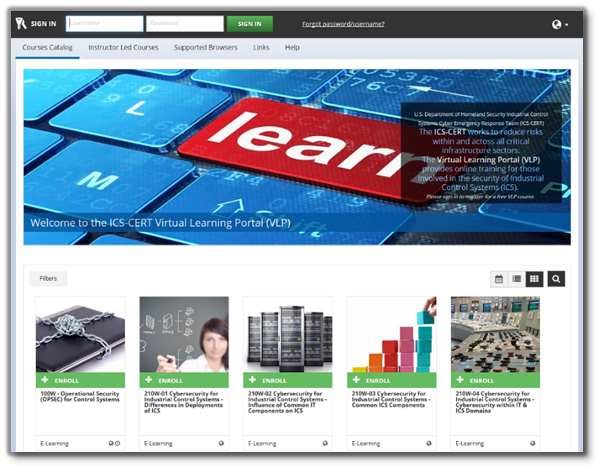
ICS Training Opportunities
ICS-CERT Virtual Learning Portal (VLP)
Virtual & Instructor Led Training
No Cost
Courses:
Introduction to Control Systems Cybersecurity (101) - 8 hrs
Intermediate Cybersecurity for Industrial Control Systems (201) - 8 hrs
Intermediate Cybersecurity for Industrial Control Systems (202) - 8 hrs
ICS Cybersecurity (301V) - 12 hrs
ICS Cybersecurity (301L) - 5 days
ICS Cybersecurity (401) - 5 days
https://ics-training.inl.gov/learn/signin

Slide 18
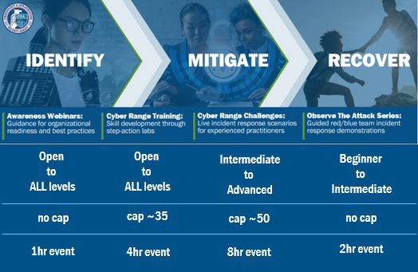
IMR Training Series
The Identify, Mitigate, and Recover (IMR) incident response curriculum provides a range of training offerings encompassing cybersecurity awareness and best practices for organizations, live red/blue team network defense demonstrations emulating real-time incident response scenarios, and hands-on cyber range training courses for incident response practitioners.
Topics for Awareness Webinars & Cyber Range Training:
Ransomware
Cloud Security
Business Email Compromise
Vulnerabilities of Internet-Accessible Systems
Web and Email Server Attacks
DNS Infrastructure Attacks
High Value Assets/Critical Assets
Indicators of Compromise
Incident Analysis with tool demo
Investigating logs for incidents
Topics for Cyber Range Challenges & Observe the Attack Series:
Ransomware
Cloud Security
Business Email Compromise
For more info: education@cisa.dhs.gov
Or visit: https://www.cisa.gov/incident-response-training

Slide 19
Incident Reporting

Slide 20
Phishing and Incident Reporting / Malware Analysis
24x7 contact number: 888-282-0870 | central@cisa.dhs.gov
Where/How/When to Report Incidents: https://www.cisa.gov/forms/report
If there is a suspected or confirmed cyber attack or incident that affects core government or critical infrastructure functions and/or results in the loss of data, system availability or control of systems.
Report Phishing to: phishing-report@us-cert.gov
CISA partners with the Anti-Phishing Working Group (APWG) to collect phishing email messages and website locations to help people avoid becoming victims of phishing scams.
Advanced Malware Analysis Center: https://malware.us-cert.gov
Provides 24x7 dynamic analyses of malicious code. Stakeholders submit samples via an online website and receive a technical document outlining the results of the analysis. Experts will detail recommendations for malware removal and recovery activities.

Slide 21
CISA REGION 6
Andrew Buschbom
State Cybersecurity Coordinator
Region 6 | New Mexico
Cybersecurity and Infrastructure Security Agency
EMAIL: andrew.buschbom@cisa.dhs.gov
CELL: (505) 302-4299
Felix Villa
Cybersecurity Advisor
Region 6 | El Paso, TX & Las Cruces, NM
Cybersecurity and Infrastructure Security Agency
EMAIL: felix.villa@cisa.dhs.gov
CELL: (575) 446-2749
CISA INCIDENT REPORTING SYSTEM
https://www.cisa.gov/forms/report
CISA CENTRAL - 24/7 Watch
(888) 282-0870; report@cisa.gov
FBI’s 24/7 Cyber Watch (CyWatch)
(855) 292-3937; CyWatch@fbi.gov
21

