Slide 1
what makes good regulation and why good regulations matter
Zachary Ogaz, General Counsel, New Mexico Environment Dept.
November 13, 2023

Slide 2
Why make a rule?
Regulations are written by state or federal agencies to help support, clarify, or implement statutes enacted by the Legislature.
- Regulations are subordinate to statutes and must work within the legislative framework
Set expectations and define terms for the public and agency; clarify permitting requirements and; establish agency procedures and standards;
- Strengthen enforcement

Slide 3
Common types of regulations
Permitting Requirement
Administrative procedures and appeals
Define or modify standards
Establish administrative areas

Slide 4
What makes a good REGULATION?
Accessible and easy to understand
Clear and Specific Requirements – holds the regulator and public accountable
Broadly applicable, consistently applied
Enforceable – Agencies must have authority under state and constitutional law to enforce the regulations
Provide certainty; improve trust; increase compliance, strengthen enforcement, and decrease frustration between the public and the regulating agency.

Slide 5
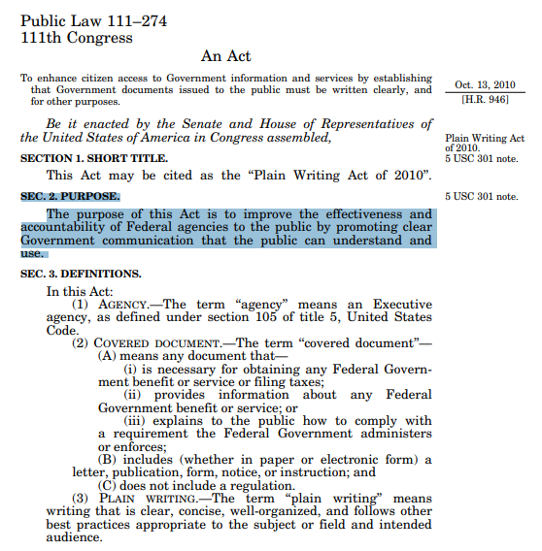
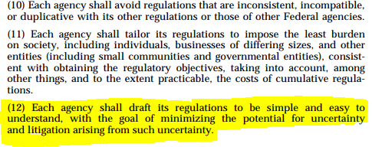

Slide 6
broad v. Specific
broad
specific
Can be applied in a uniform basis, includes everyone within a single category
Provides clarity in area that needs particular attention

Slide 7
Example of a Broad rule

Slide 8
Example of a Specific Rule

Slide 9
Regulations must be enforceable
Agencies must have constitutional and statutory authority to enforce its regulations
You may draft a regulation with a plausible interpretation under the law, but the closer the regulation is based on statutory language, the more likely you will receive a favorable reading in any court if the regulation is challenged.
Must be supported by evidence

Slide 10
Tri-state v. d’antonio
Tri-State Generation Transmission Assn. v. D’Antonio, 2012-NMSC-039, 289 P.3d 1232
Separation of Powers Issues – Did the Office of the State Engineer have the authority to promulgate Active Water Resource Management regulations (AWRM)- 19.25.13.6 NMAC?

Slide 11
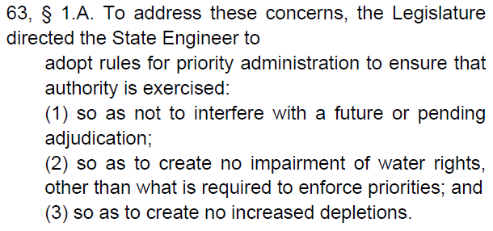
Tri STate

Slide 12
Arguments made by tri-state
The AWRM regulations violated separation of powers principles – the State Engineer did not have the authority to issue AWRM, and usurped the power of the judiciary because water priorities could only be determined by an adjudication court.
Due process was violated – deprivation of a water right; and delay between preliminary administration and resolution after hearing was too great
Regulations were too vague to be enforced consistently- there was no clear or meaningful standard to judge the best available evidence used by the State Engineer

Slide 13
NM supreme court decided against tri-state
AWRM did not violate separation of powers principles;
The newly promulgated Section 72-2-9.1provided new authority to the already broad authority of the State Engineer
State Engineer was simply exercising its authority to administer water rights outside of the adjudication process.

Slide 14
NM supreme court decided against tri-state
AWRM did not violate due process
Regulation of a water right does not amount to a deprivation
Best available evidence was not unconstitutionally vague
See Bokum Res. Corp. v. N.M. Water Quality Control Comm'n, 93 N.M. 546, 549, 551-52, 603 P.2d 285, 288, 290-91 (1979); and N.M. Mining Ass'n v. Water Quality Control Comm'n, 2007 NMCA 84, ¶ 24, 142 N.M. 200, 164 P.3d 81

Slide 15
Key takeaways from all of the above
Challenges to regulations can come from many different angles
Constitutionality, lack of statutory authority, vague enforcement provisions, lack of evidence in support
Well written rules help the public find requirements quickly and understand them easily.
When properly enforced, good regulations improve trust in the government and improve efficiencies in administrative processes because the regulator and regulated parties know what is expected of them.

Slide 16
Bad Regulations are therefore…
Unconstitutional or in Conflict with the Law or Outside of Statutory Authority
Vague, ambiguous, or overbroad– regulations should be clarifying how the agency will act in a specific scenario, not further muddying the waters. Don’t make readers do further research to understand what you might be saying
Allow for inconsistent and arbitrary and capricious application of regulation

Slide 17
What’s the process?

Slide 18
New Mexico’s state rules act NMSA 1978, §§ 14-3-24 to -25, 14-4-1 to -9

Slide 19
What’s the process?
Draft
Notice
Public Comment
Opportunity to challenge/protest
Publication

Slide 20
drafting a regulation
Prepare – understand subject matter, purpose, audience, process, applicability, and laws
Organize –group and sequence rules in a coherent and logical fashion; collect data and evidence to support the rule
Write –
Use concrete words, not abstract ones, and use precise terminology
Place negative words near the front of the sentence to tell reader that something is restricted
Avoid legalistic writing to the extent possible
Categorize by inclusion instead of exclusion
Avoid gaps, overlaps, and contradictions
Review, revise, and proofread – double check for may, can, and must

Slide 21
Put the public on notice
Publication in a local newspaper for a period of time
Tell the public what changes are going to be made, who is affected, and how they will be affected
Must be specific enough to provide the public with notice of the actual affect; slight changes later in the process may be acceptable, but large deviations may require republication
Provide interest holders with the information needed to decide what steps to take next, and allow for feedback on proposed rule.

Slide 22
Notice must comport with constitutional due process and statutory requirements
Notice must provide adequate time to prepare to respond.
Slightly different but heed the lesson in Wells Fargo v. Dax, 93 N.M. 737 – It was undisputed that the attorney for the defendant Dax received notice of a key hearing 15 minutes after the hearing was scheduled to begin.
Time and substance are keys to meeting standard.

Slide 23
Public Comment
Allow the public to provide formal feedback to the proposed rule.
This may result in slight changes to the rule, major changes, or no changes.
All public comments should be reviewed and responded to as needed
Build in more time than needed for comment

Slide 24
Unresolved disputes and challenges
There must be an opportunity to challenge the rule.
A member of the public that has properly challenged a rule is entitled to:
a neutral decision-maker
an opportunity to make an oral presentation to the decision-maker
an opportunity to present evidence or witnesses to the decision-maker
a chance to confront and cross-examine witnesses or evidence to be used against the individual
the right to have an attorney present the individual's case to the decision-maker
a decision based on the record with a statement of reasons for the decision
See Titus v. City of Albuquerque, 149 N.M. 556, 560

Slide 25
Who could challenge a regulation?
Anybody
Industry groups
Non-profit associations
Other governmental agency
Individuals or corporations

Slide 26
Basis for challenges
Unconstitutional
Vague, separation of power, deprivation of due process, deprivation of property
Arbitrary and capricious
Lack of evidence in support
Failure to follow rulemaking rules

Slide 27
Example to wrap up- Marker v. N.M. oil conservation commission
Challenge to NM Oil Conservation’s rulemaking that amended the rules of financial assurance.

Slide 28
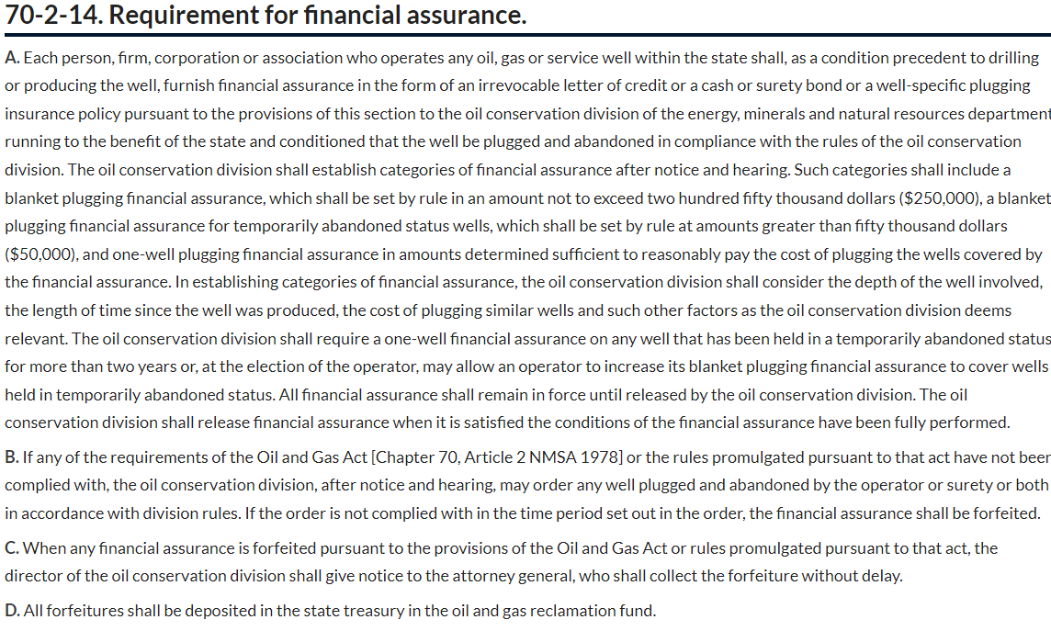

Slide 29
Short Synopses of Marker
Commission promulgated a rule to implement the increase, and proposed four tiers of blanket assurance. In 2018, the legislature amended the cap on blanket assurance to $250,000 up from $50,000.
After providing notice and an opportunity to comment, Marker and other members of the regulated community met with the OCC, and collectively made an amendment to the rule.
There was a rehearing on the matter, where a further amendment was made.

Slide 30
Marker argued
Unhappy with the amended rule, Marker argued 1) the amended rule was not supported by substantial evidence, 2) the adoption of the rule was arbitrary and capricious, 3) the commission did not follow the required rulemaking procedures, and 4) the commission violated Markers procedural due process rights.
Marker also argued the hearings were unfairly biased against him and the new rules would have a retroactive affect on his vested rights.

Slide 31
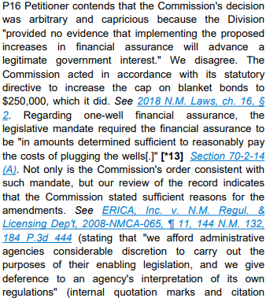
The court didn’t buy any of it
The Commission considered and provided evidence of a number of factors and evidence that supported the rate structure adopted.
Rulemaking rules were followed; notice was proper
Petitioner failed to identify any legitimate liberty or property interest that was being deprived.

Slide 32
Broad takeaways
Stick closely to the statutory language that has granted rulemaking authority.
Have plenty of evidence in support
Know the requirements for providing notice and follow them closely
Provide clear and easy to understand language

Slide 33
final recap
Accessible and easy to understand
Clear and Specific Requirements – holds the regulator and public accountable
Broadly applicable, consistently applied
Enforceable – Agencies must have authority under state and constitutional law to enforce the regulations
Provide certainty; improve trust; increase compliance, strengthen enforcement, and decrease frustration between the public and the regulating agency.

Slide 34
Questions

