Slide 1
PRC CLE: Emerging Issues in Regulation Topic: Return on Equity (“ROE”) Marc Tupler Senior Economist NM PRC Utility Division Staff

Slide 3
ROE Basics:

Slide 7
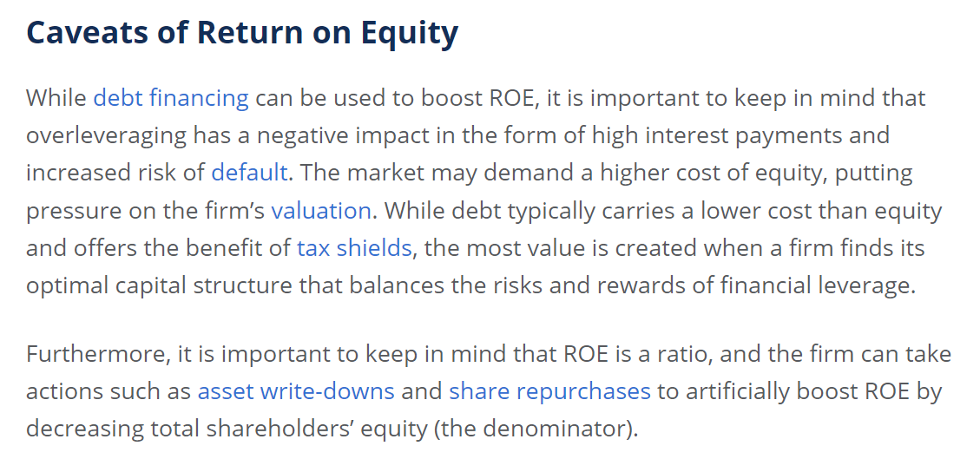

Slide 8
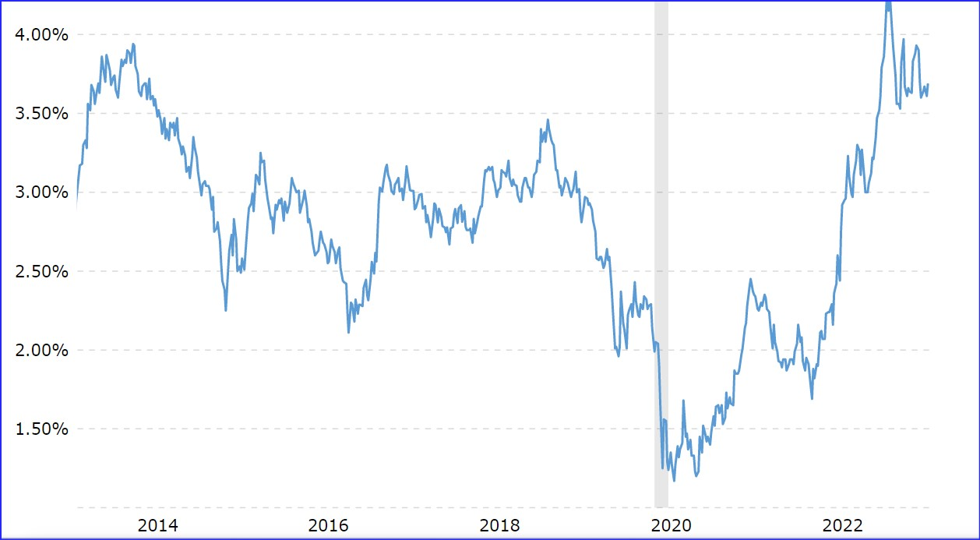
30-year UST yield, past 10 years

Slide 9
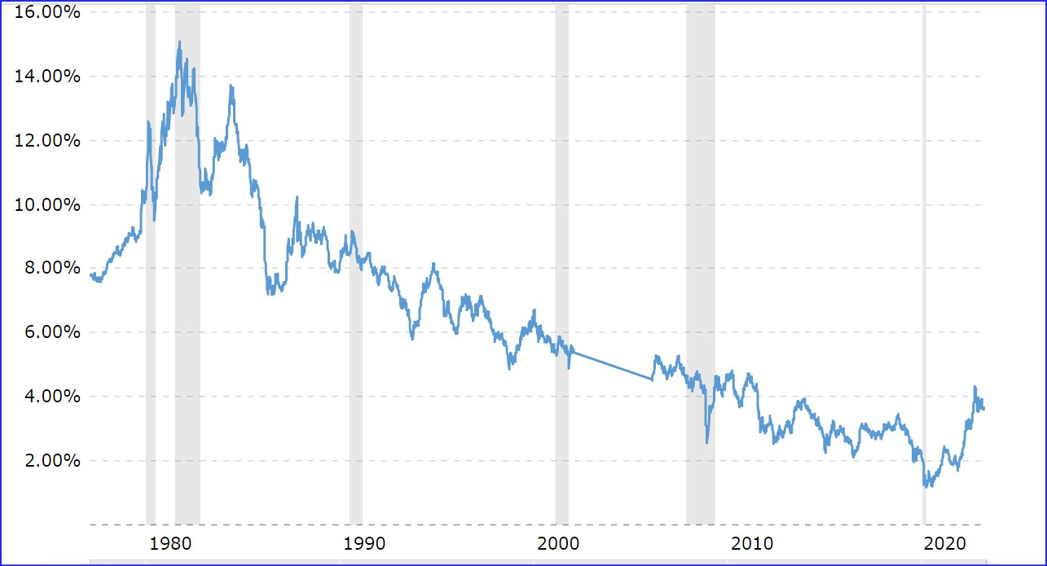
30-year UST yield, past 40 years

Slide 10
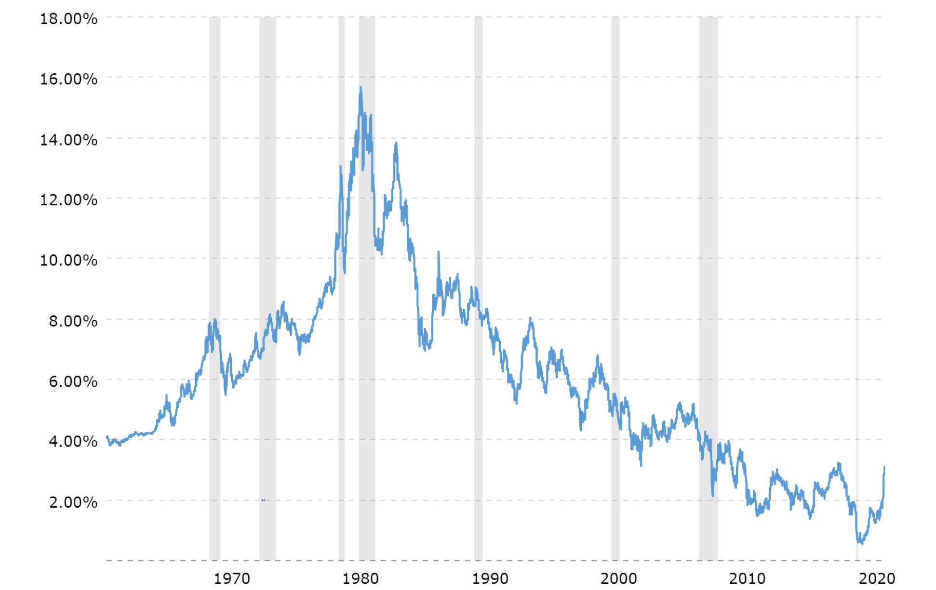
30-year UST yield, past 65 years

Slide 11
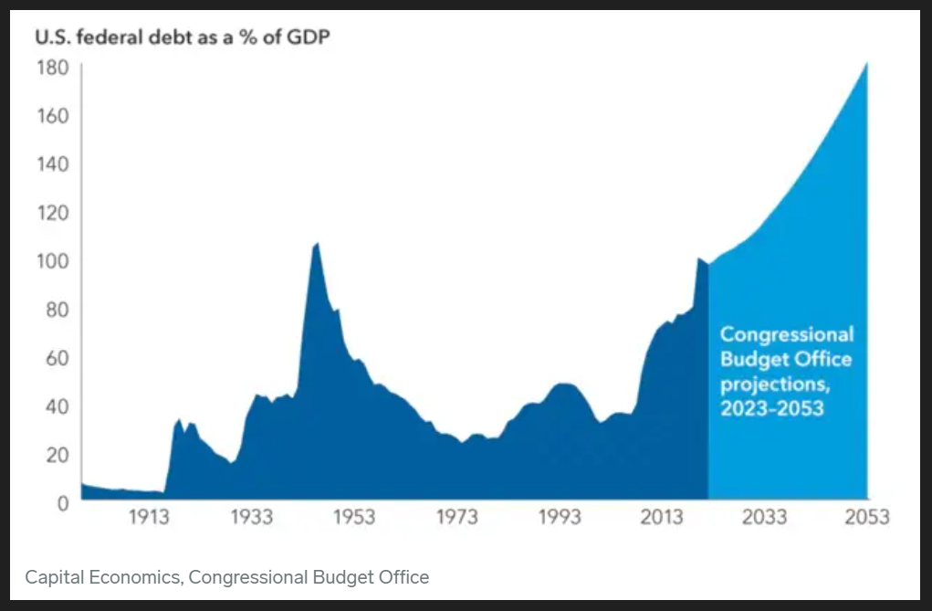
US federal debt as a % of GDP

