Slide 1
Writing For Your Audience: How to Make Your Point With Different Readers
Erin Lecocq
Appellate Specialist
New Mexico Public Regulation Commission

Slide 2
“We should not speak so it is possible for the audience to understand us, but so that it is impossible for them to misunderstand us.”
Quintilian, 1st Century
Notes:
I like this quote because too often we strive to try to get our point across rather than ensure that when it is read, it will be understood and NOT misunderstood.

Slide 3
Agenda
Writing in General
Writing for your Audience
Write for Understanding
Plain is Professional!
Notes:
We are going to talk a little about writing in general, knowing what the purpose of our writing is, which will help us tailor it for our audience, and then we will talk specifically about ways to identify and write specifically for that audience. We’ll talk about how we write for understanding while still being persuasive, how to be credible and professional while still being assertive, and how plain language really is more professional.

Slide 4
Tailor Writing for Your Audience
Know who you’re writing for
Know what the purpose of your writing is
Develop credibility with your audience
Write for understanding

Slide 5
Why do we write?
- Communicate: The primary way to convey arguments and information.
- Advocate: Effective writing can persuade judges, clients, and opponents.
- Analyze: Helps you analyze, research, and understand the law.
- Show Professionalism: Reflects your competence and credibility.
- Create, Express, Entertain: Bring something new into the world, tell how we feel about something, make someone laugh or cry
Notes:
I know not everyone here is a lawyer, and even if we were, we all write for different reasons right? We send a million emails every day, we write memos, reports, briefs, orders, notes, letters, etc. So there are many kinds of writing that each requires a different style because we are writing both for different reasons and to different people. If we were to write an email to a judge, it would look different than an email to a colleague. Or an email and a brief, both to a judge would be different. So we have to keep in mind both the reason/thing we are writing and the person we are writing for.
And we write in all of these ways every day, probably, without necessarily even knowing it.

Slide 6
What is the Purpose?
Technical:
Revenue Requirement Formula:
RR = O + T + d + r (RB)
RR = Revenue Requirement
O = Operating Costs
T = Taxes
d = Depreciation
r = Rate of Return
RB = Rate Base
Informative:
The revenue requirement formula helps determine how much money a company or service provider needs to cover its expenses, make a profit, and pay taxes. The formula utilizes the operating costs, taxes, depreciation, the rate of return, and the rate base to make this determination.
Persuasive:
This approach has proven to be an equitable and efficient means of determining the just and reasonable rates for utilities, ensuring a fair balance between the interests of both consumers and providers. By taking into account the costs of providing the service, including operating expenses and a fair rate of return, the revenue requirement formula ensures that essential public services remain financially viable and that consumers are not burdened with exorbitant costs.
Notes:
SO let’s talk about purposes of writing. I picked three that we use most often at the PRC that can show the difference between different purposes of writing essentially the same thing.
o, let’s take the revenue requirement formula, which, if you’re talking about the RR formula, and you’re talking to person about it who knows what you’re talking about if you were to know them this, then you probably don’t need to add any additional information.
But if you’re trying to explain it to someone else, you might want to do it this way.
And if you’re trying to persuade someone to use it as an approach, you might do it this way.
Each has the formula built in, but uses it in a way that is meant for the audience.

Slide 7
Writing for Your Audience
Write for your audience (not for yourself)
Consider all who might be included in the audience
Cases/Orders – used by utility, attorneys, public, judges, regulators, Commissioners
Understand how and when readers will read it
Look at material from readers’ perspective and remove common barriers
Avoid shorthand/initials and explain in the text rather than in a footnote or beginning glossary
Notes:
Ok, so once we know what the purpose is of what we are writing, we need to figure out who is going to read it. The main point here is that you are not writing for yourself, unless it’s a journal or something. But unlikely in a professional context. ☺ So yes, you know what you are saying, but remember the point is to make your points understood – and keep them from being misunderstood – So before you start writing, think of all the people who might read it. If you’re writing a proposed order, it will be other attorneys, clerks, the judge, and eventually the client and the public. Keep all those in mind when you’re writing and try to understand how and when they will read it. When you’re reviewing it, try to look at it from the readers’ perspective and remove common barriers – this is especially important here because we have so many acronyms and shorthand, but the judges and the public are not going to know those. It’s better to put them in the text directly than to have a glossary or footnote because those disrupt the flow of the reading, but if you’re only writing for another group of people who understands that shorthand, you can probably just include a glossary that may or may not be referenced.

Slide 8
Who do we write for?
Colleagues
Opposing counsel
Judges
Mediators
Regulators
Parties
Technical and business professionals
The public
Organizational clients
Elected officials
Notes:
So, who do we normally write for? It’s a lot to keep in mind, but if you think of everyone who might need to read what you’re writing and write for the “lowest common denominator” you should be able to make yourself understood.

Slide 9
Most readers:
Are busy and have little time, attention, and patience
More likely to read material that is clear, concise, and focused on an issue they understand matters to them
Notice tonal, cultural, or political disconnects or factual premises they consider inaccurate (and can discredit the material)
Put yourself in the shoes of your reader:
Notes:
For the “LCD,” put yourself in the shoes of your reader. Do they work in this field? Do you need to explain or persuade? Do you need to help them care about and pay attention to what you have to say? Keep in mind that most people don’t have the time, attention, or patience to read hundreds of pages. If you want to make your point – whatever you point is – you will need to be clear, concise, and focused and you’ll need to make whatever the issue is matter to them. You want a good “elevator speech.”
So let’s look at an example outside of what we do of a way this was done really, really well:

Slide 11
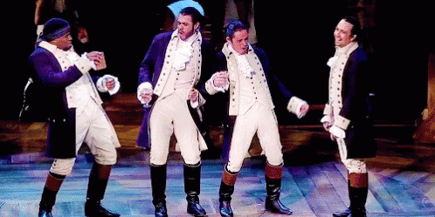
Tailored for an Audience
Hip-Hop and Rap – Different from normal “Broadway”
Diverse Casting
Accessible Language
References to Pop Culture
Resonate and Relate
Notes:
Miranda recognized that the story of Alexander Hamilton, a Founding Father of the United States, might not automatically resonate with a contemporary and diverse audience. To bridge this gap, he decided to use hip-hop and rap music, which are more accessible and relatable to many people today. This choice not only made the story more engaging but also highlighted the parallels between Hamilton's struggles and those of marginalized communities.
"Hamilton" features a racially diverse cast, with actors of various ethnic backgrounds portraying the historical figures. This casting choice was intentional, emphasizing the idea that the American story belongs to all, regardless of their racial or ethnic backgrounds. It resonates with modern audiences by connecting the past to contemporary issues of diversity and inclusion.
The use of contemporary language and slang in the lyrics of "Hamilton" makes the story more accessible to a broad audience. The dialogue and lyrics feel relatable, which allows audiences to connect with the characters on a personal level.
Miranda included references to popular culture, such as hip-hop and classic Broadway, to create a bridge between different musical genres and generations. These references help to engage audiences who might not typically be interested in historical narratives.
"Hamilton" premiered in 2015, during a time of intense political and social discussions in the United States. The themes of immigration, power struggles, and the role of government in the musical are highly relevant to contemporary issues. By aligning the musical with the zeitgeist, Miranda ensured that it would resonate deeply with the audience's concerns and interests.
In summary, Lin-Manuel Miranda tailored "Hamilton" for his audience by choosing a musical style and casting that would engage modern, diverse, and often underrepresented audiences. He used relatable language, references to contemporary culture, and connected the historical narrative to contemporary issues. These choices allowed "Hamilton" to not only entertain but also educate and provoke important conversations about the past and present.

Slide 12
Develop Credibility
Notes:
Your message won’t resonate if no one takes you seriously. Do be taken seriously, it’s essential to develop credibility with your audience.
Old adage about law school reputations
It’s the same way with judges, colleagues, etc – whoever your audience is
Supreme Court CLE– be transparent, admit when you are wrong, show all sides and persuade why you’re right

Slide 13
Develop Credibility with your Audience:
Avoid over-the-top language:
Use language that presents yourself as reasonable, thoughtful, and confident; avoid language that makes you sound elitist, whiny, or pushy.
"Incredibly, it appears that the Commission lacks the basic intelligence to comprehend the basis of our argument. It's a travesty that we even have to waste our time on this.“
Notes:
Here are a couple of examples from emails I’ve actually received– I changed a few things– but sometimes I think that when you’re trying to be assertive, it comes out as whiny, pushy, and overly dramatic. This can have the opposite effect of what you’re hoping for – the Court will not take it seriously, and neither will opposing counsel (or anyone else) and you’ll lose your credibility.

Slide 14
2. Don’t name call, use sarcasm, or make petty characterizations:
Avoid any sort of name calling and petty characterizations—whether it be about parties, attorneys, or anything else. You should state the facts about what a party or attorney has done.
“Yes, indeed. Let’s ask for additional time for a matter that was dismissed for taking too long to adjudicate. Makes absolute sense to me. Tell me, has the request to take more time been authorized by the Commission, or is this a self-serving interest of your own?”
“You don’t get to curb our speech criticizing our government officials. Kindly refrain from behaving in such an unconstitutional fashion. So in other words ‘shush.’ Thanks.”
Notes:
Sarcasm never comes out well in written form (and should be avoided in oral arguments as well!)
Similar to the last slide, instead of getting your point across, your audience will (probably) laugh or sigh and write you off – having the opposite effect of what you want

Slide 15
3. Focus on the law and the merits of your case or the facts. Avoid statements that imply the opposing side (or whoever you’re writing to) is acting with a certain intent.
Even in adversarial situations, frame the argument in a way that weakens the other side’s argument, rather than implying bad faith or some nefarious intent, unless that is the specific argument.
“Joe’s Power Company is clearly trying to bootstrap the court.”
“Sadie's Alliance for the Environment is disingenuous in its statements.”
“Ernie’s Utility Company evidently did not read the order.”
Notes:
Don’t guess at intent from the other side – you don’t know what they’re doing and attacking their intent weakens your argument. Attack the merits of the case.

Slide 16
4. Maintain a consistent style and tone such that when a single sentence or phrase is scrutinized, it stands on its own as reflection of the intent of the entire document.
“Uncle Pennybag’s Electric Company alleges that the Commission violated its due process rights in violation of the Commission’s regulations and statutes. This is a big no-no. We're not here to play games, and the Commission’s actions were not okay.
Notes:
Suddenly becoming informal in a formal brief or memo brings the reader out of the “logic” space and can stop following you. It’s ok – as we’ll see later – to be informal, but be consistent with your tone throughout rather than put in something quippy that doesn’t belong.

Slide 17
Write for Understanding
Notes:
The mechanics of writing are important to ensure that you’re being understood – you want to pay attention to readability, to style, to fluidity, and to making it as easy to read as possible. Use a structure that’s clear and logical so the reader can follow your “big picture” as well as the details of what you want to say.

Slide 18
Be Structured
Group information in meaningful chunks
Put information in an order that works well for audience
Orient with navigational tools
Use plenty of headings and subheadings
Notes:
Make a framework with headings, topic sentences, etc that is easy to follow
Make them specific and informative
Reading the Table of Contents should give the reader a full picture of the arguments in the brief

Slide 19
Readability:
A Note About Footnotes
Use a single font
Bold or underline (or both) headings, but be consistent
Italicize or underline citations, but be consistent
Use your words for emphasis
Avoid italicizing or bolding or ALL CAPS for emphasis
Make sentences simple and varied in length; avoid stringing long clauses together
Be direct, specific, and concrete
Give context first and incorporate definitions into the text
Use technical terms only when readers need to know them, define acronyms in the text
In general, avoid them. ^{1, 2, 3}
¹ Anything you want to say should be in the text.
² Use parentheses, colons, semicolons, etc. to separate the thoughts.
³ Use sparingly when citing to something that does not need to be looked at immediately

Slide 20
Plain Language Revolution
Move away from “legalese” to clear, concise language understandable by everyone
Notes:
There’s a change in legal writing moving toward writing in plain language – again, so as to avoid being misunderstood. Legalese sounds fancy but you can say a lot without actually saying much. This is a really good example from Legally Blonde that illustrates it pretty well.

Slide 21
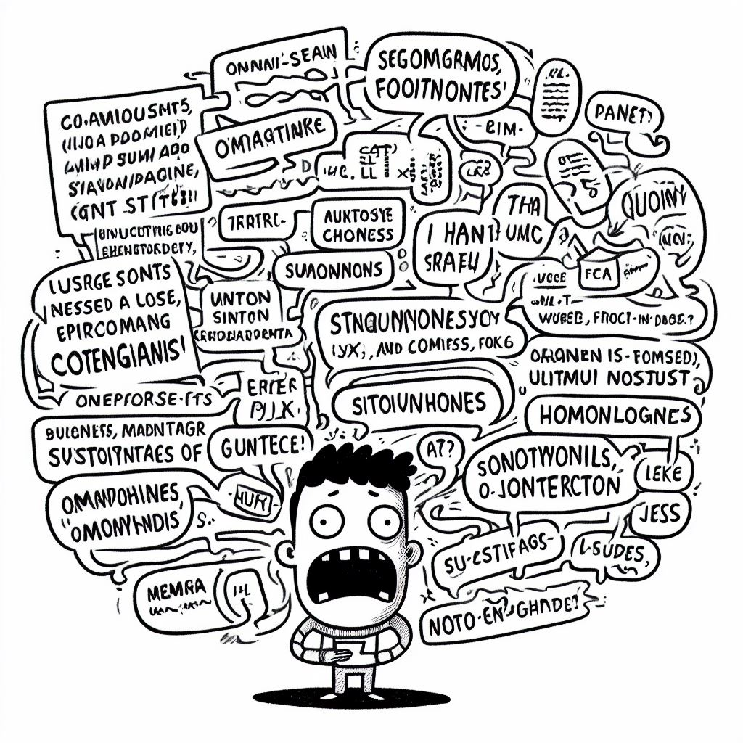
Plain Language:
Avoids verbosity, pretentions language, and tortuous sentence structures
Includes and presents complex information in a clear and orderly way
Is direct, easy to read, and looks like it’s meant to be read

Slide 22
Plain is Professional
“You achieve plain English when you use the simplest, most straightforward way of expressing an idea. You can still choose interesting words, but you’ll avoid fancy ones that have everyday replacements meaning precisely the same thing.”
Garner, Legal Writing in Plain English, p. xiv
Notes:
People tend to think that plain language is not professional, but it is. The point is to get your point across as clearly and succinctly as possible.

Slide 23
Clear, concise language conveys meaning
Original “legalese”
Plain Language
The appellant, by an order extending the time to file his transcript, made by the district judge of Chaves county, was given until the 17th day of February, 1912, to file such transcript. The transcript was filed with the clerk of this court on the 3d day of February, 1912, and within the time allowed; but no assignment of errors was filed, and on the 12th day of March thereafter, and after the expiration of the return day, appellee filed a motion to dismiss the appeal, because of the failure to file assignment of errors. Lund v. Gilbert, 1912-NMSC-029, ¶ 1, 17 N.M. 265, 125 P. 602, 603
The Court in Chaves county granted Appellant additional time to file the record proper of the case. The Court gave a deadline of February 17, 1912, but Appellant filed it on February 3, 1912, which was within the time ordered by the Court. However, Appellant did not include assignments of error. Then, on March 12, after the deadline provided by the Court, Appellee moved to dismiss due to Appellant failing to file the assignments of error within the time allocated by the Court.
Notes:
Here’s an example – granted this is old but it’s a good way to see how your point can still be made– and be made more understandable– without the flowery language

Slide 24
Active Voice
Passive Voice
“The Commission regulates utilities.”
The subject is the Commission and performs the action on the object
“Utilities are regulated by the Commission.”
The subject isn’t doing anything; it is being acted on
Active voice states a simple, direct, and logical flow from a subject that is performing the action
easier to understand
Avoids vagueness
Shorter
Reduces active emphasis and can be unclear
Longer
Can be used to avoid blame or responsibility: “mistakes were made”
Notes:
Just a quick note about passive and active voice. Passive voice gets a bad rep, with good reason sometimes. When used to make something more flowery, it can be confusing and the reader can lose track of what you’re saying. BUT passive voice has a place. It’s helpful to skirt blame or to de-emphasize an action. Use both as effectively as possible.

Slide 25
Summary
Think of the purpose of your writing and who you are writing for
Be credible
Be clear

Slide 26
Thank you
Erin Lecocq
Erin.Lecocq@prc.nm.gov

