Slide 1

Mindfulness in Decision Making: Increasing Professionalism AND AVOIDING BURNOUT through Thoughtful Response AND CULTIVATING PRESENCE
Scott Cameron, Esq.

Slide 2
Who AM I AND WHAT QUALIFIES ME TO TEACH THIS CLASS?
I’ve been a practicing public interest attorney for 22+ years,
have been trained to teach adult Mindfulness Based Stress Reduction (MBSR) by UCSD and children by Mindful Schools,
practiced mindfulness meditation for nearly 20 years and experienced firsthand the benefits,
have been on several multi day meditation retreats,
have taught mindfulness to kindergartners, high schoolers, parents, families, lawyers, and judges, and
have been a TEDx speaker sharing my experiences teaching mindfulness in schools.

Slide 3

Today
Presence
Awareness
The effects of the lack of these two
How to get more presence and awareness to improve decision-making

Slide 4

What is presence?
Good question!

Slide 5
The opposite of Presence is…
ABSENCE
In conversations with clients, colleagues, even family and friends.
While doing work.
While driving (“I don’t remember actually getting here”).

Slide 6
TRY THIS DEFINITION FOR PRESENCE
At any given moment, being AWARE of what is happening in your:
  Body
  Emotions
  Mind
  This is a practice you can only do right now, in this moment.
  And this one.
  And this one.

Slide 7
Try it right now
Check in with your physical self, your BODY.
  Can you feel your seat in the chair? Feet on the ground? Can you feel your hands?
What do you notice about your EMOTIONAL STATE?
  Can you notice anything? Calm? Irritation? Joy? Is it blank?
What do you notice about your mental state, your MIND?
  Is your mind busy? Calm? What thoughts are you thinking?

Slide 8
Why bother?
Calmer, less reactive, respond rather than react (stay tuned…)
Better relationships, more actual connection
Improved effectiveness; more data for you when you include your BODY and EMOTIONS (think EQ). When you just rely on your mind, you’re operating from a ‘limited bandwidth”.
Your MIND will work better and you can notice when it is causing trouble.
Improved decision-making abilities. Good decisions follow from good presence.
Able to fully participate in the gift of the present.

Slide 9
Challenges
NOT UNCOMMON FOR LAWYERS TO BE:
Unhappy at work (overworked, difficult relations with clients or colleagues, lack of meaning)
Unhappy in personal lives (strained relationships, not enough time)
Feeling like they’re not fully at home when they’re home, or at work when they’re at work (i.e., not present in either place); ineffective in both places
Beginning in March, 2020, increasingly stressed dealing with uncertainty
Making unskillful decisions; reacting rather than responding
Many more symptoms (see the many and varied support programs offered by the Bar)
Suffering from Lawyer Burnout

Slide 10
WHAT IS LEGAL (LAWYER) BURNOUT
Lawyer burnout is chronic exhaustion as a result of too much on your plate. Lawyers without an efficient system in place can find themselves disillusioned, overworked, and ultimately emotionally distressed. Exacerbating the issue is work martyrdom — the propensity to put the well-being of your clients and organizations/agencies before your own.
The commitment attorneys have to their clients and their work often translates to an “I’ll sleep when I’m dead” kind of a mindset, creating an always-on culture that leaves little room for a break.

Slide 11
WHAT ARE THE SIGNS OF LAWYER BURNOUT?
Fatigue
Social withdrawal
Headaches
Absenteeism
Getting less work done overall
Taking longer to complete tasks
But perhaps the most serious symptoms of burnout are inefficiency and inattention to detail which lead to poor decisions – vital areas for any practicing attorney

Slide 12
Burnout Self-Test: Maslach Burnout Inventory (MBI)
The MBI is the most commonly used tool to self-assess whether you might be at risk of or suffering from burnout. To determine the risk of burnout, the MBI explores three components: exhaustion, depersonalisation and personal achievement.
Let’s try it-

Slide 14
What Can We Do ABOUT OUR SCORES??????
Our path to wellness begins with one small step. Presence and Awareness.
Awareness by any other name…

Slide 15
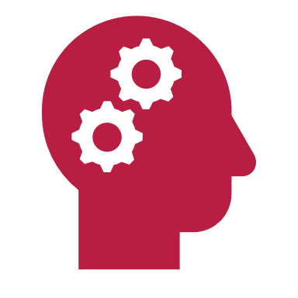
Mindfulness!!

Slide 16
What is Mindfulness?
Technical definition: non-judgmental present-time awareness
Everyday definition: to be fully aware, to be fully present, to simply be. . .
  The practice of being aware of the moment, the person, your actions and thoughts as the world interacts with you and your actions and thoughts.
  To be mindful is to not allow prejudices, preformed judgments, or errant emotions make your decisions.
  It is the ability to see the situation completely as it is without all the other (internal) clutter.
  Being in the Flow
  Fully alive
  The gift of the present

Slide 17
How is Mindfulness Strengthened?
Traditionally, through meditation!
Famous meditators:
  Dalai Lama.
  Oprah.
  Hugh Jackman.
  Paul McCartney.
  Angelina Jolie.
  Katy Perry.
  Jerry Seinfeld.
  Lady Gaga.
  Phil Jackson (and the Chicago Bulls).
  Pete Carroll (and the Seattle Seahawks)
  Congressman Tim Ryan
  Former ABC news anchor Dan Harris

Slide 18
THE Science
Research shows that voluntary slow deep breathing functionally resets the autonomic nervous system through stretch-induced inhibitory signals and hyperpolarization currents propagated through both neural and non-neural tissue which synchronizes neural elements in the heart, lungs, limbic system and cortex.
What??????

Slide 19
THE Science (EXPLAINED)
In other words, deep breathing-
  slows everything down,
  connects you with your higher thinking,
  allows you to respond rather than react when making decisions, and
  Gives you the ability to NOTICE (be aware) of your burnout symptoms so you can take appropriate action.

Slide 20
HIGHER BenefitS of Mindfulness
MINDFULNESS CAN POSITIVELY IMPACT BOTH MENTAL AND EMOTIONAL HEALTH
"Studies have shown that rumination and worry contribute to mental illness and that mindfulness-based interventions are effective in the reduction of worry,” says Ellen Langer, a professor of psychology at Harvard University
In the workplace, in relationships, and at home, mindfulness can increase engagement and emotional intelligence.
More effective friend, partner, parent, advocate, lawyer, leader, decisionmaker

Slide 21
How is Mindfulness Practiced?
MINDFUL POSTURE- let’s try it please-----
Bodies very still, back head and shoulders straight, hands in lap, eyes closed or half closed
If in chair, feet on floor or cushion/pillow
If sitting on floor on cushion/pillow, try for 3 points of contact – stability is key, along with comfort. But not too comfortable!
Sitting like a mountain or a rock
Upright, but not uptight

Slide 22
How is Mindfulness Practiced II?
POSTURE + MINDUL BREATHING- let’s put the 2 together and try it out:
With the posture just adopted, please allow yourself to just be present where your body is
Bring attention to your breath, wherever you may find it (belly, chest, throat, nostrils) and without trying to breathe a certain way. Notice the movement of the air in and out of your body as you inhale and exhale
Pay closer attention to the breath, following it in and out. Follow your inhalation from the beginning, to the middle, to the end. Then follow your exhalation the same way – beginning, middle, end
When your mind wanders from the breath (not “if”, because it will!), that’s OK – gently guide it back to your breath and begin the practice of following it again, with awareness and no judgment

Slide 23
Why Meditate?
It strengthens our ability to be mindful and allows those benefits to accrue
“There’s a sort of resilience that comes through mindfulness,” says Sharon Salzberg, a best-selling author and teacher of meditation practices. “I find if I have a regular period of meditation each day … it will change the momentum of my day from being absent or frantic. For me, meditating each day is like a muscle-training session.”
“Maybe the job description is not the job of your dreams—[through meditation] you can find meaning in every interaction in the workplace,” says Salzberg. “We would say the purpose of meditation is not to stop thinking, but to have a different relationship to your thoughts. You’re not being drawn into your thoughts; you’re not taking them to heart.”
Strengthen the ability to be mindful in all aspects of life, including work
It’s a powerful practice.
  How powerful??

Slide 24
THE POWER OF MEDITATION & MINDFULNESS…
Meditation practice isn’t about trying to throw ourselves away and become something better. Its about befriending who we already are (where we already are, in the situation we are in).
Pema Chodron

Slide 25
“[CHALLENGES] ARE Inevitable…

Slide 26
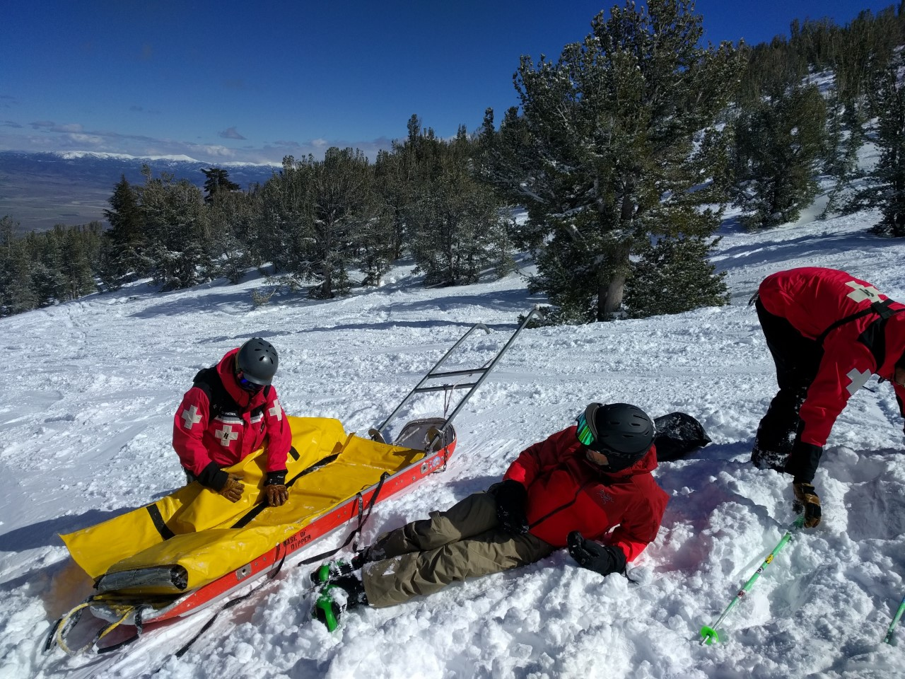
Before (2/27/17)

Slide 27
…Suffering is Optional”

Slide 28

After (3/7/21)

Slide 29
suffering = pain x resistance
(what we resist, persists)

Slide 30
Practicing Mindfulness
Make it a habit – use mindful reminders, calendar it, apps, deep breath when the phone rings, opening the door
Small activities that we do all the time (like picking up your phone, brushing teeth, eating, or washing your hands)
Start a regular meditation practice – start small
Gratitude practice-
  In the morning
  When agitated
  At bedtime

Slide 31
STOP Meditation practice
STOP DECISIONMAKING PRACTICE=
  Let’s try it-
    Stop and stand or sit up, paying attention to your posture,
    Take two deep breaths in, and one slow breath out (“the physiological sigh”) and focus on the experience of breathing,
    Observe your thoughts, feelings and actions, and
    Proceed to decide or respond with new awareness.
  You can do this in as little as 10 seconds, and nobody has to know

Slide 32
Reach out….
For questions or more information, or just to share your thoughts on what you heard today, feel free to contact me:
      Scott Cameron, scott.cameron@prc.gov.nm or
      cameronscottc@gmail.com or
      (505) 331-0252

